Slide 1
USvideos
指标统计与榜单
排名、结论、发现、不足

Slide 2
1
指标权重体系
2
指标计算结果
CONTENTS
IF YOU LIKE THIS POWERPOINT TEMPLATE,PLEASE FOCUS ON ME,YOU WILL GET BETTER.
3
研究发现
4
不足

Slide 3
指标权重体系
Chapter One
将概念量化成多级指标

Slide 4
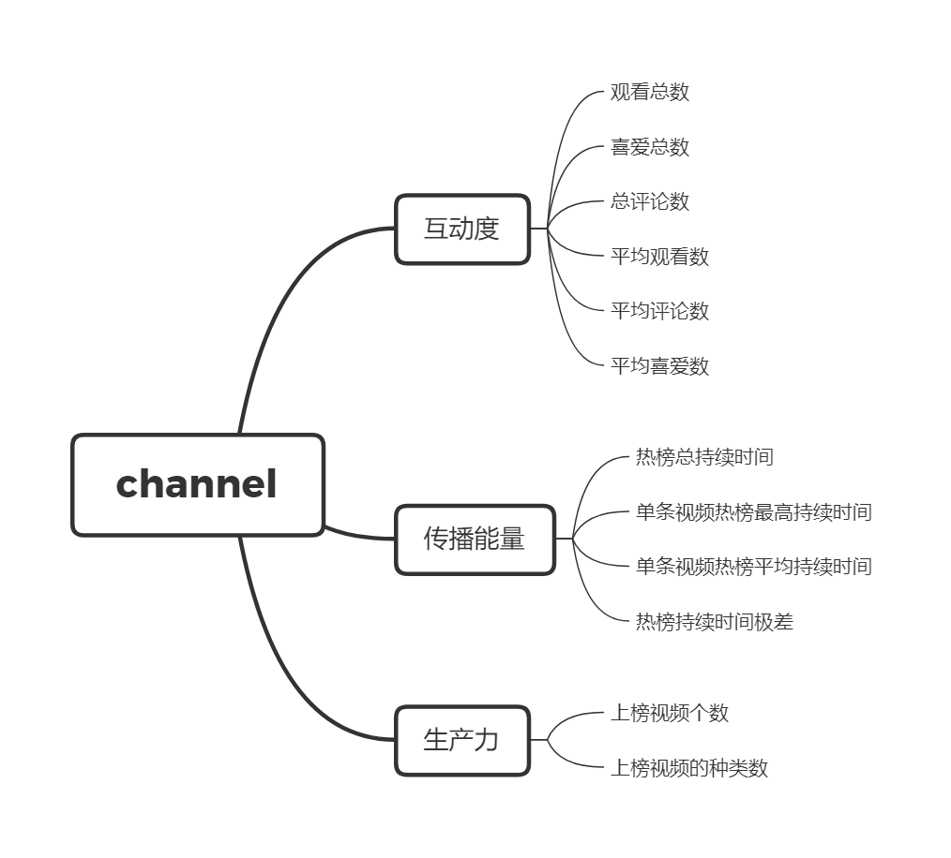

Slide 5
指标计算结果
Chapter Two
根据二级指标的三个榜单和一个总榜单

Slide 6
子榜单
top25
top25
互动榜单
高产榜单
top25
实力榜单

Slide 7
已有数据
6654
2204
视频
频道
媒体数据
互动数据
发布量、频道编号
点赞、点踩、评论

Slide 8
互动榜单
ChildishGambinoVEVO
ibighit
BeckyGVEVO
TheWeekndVEVO
LuisFonsiVEVO
MalumaVEVO
YouTube Spotlight
Dude Perfect
Ed Sheeran
ArianaGrandeVevo
Marvel Entertainment
jypentertainment
Cardi B
Logan Paul Vlogs
TaylorSwiftVEVO
FoxStarHindi
DrakeVEVO
CalvinHarrisVEVO
Selena Gomez
Sony Pictures Entertainment
Maroon5VEVO
Disney鈥ixar
EminemVEVO
ZaynVEVO
David Dobrik
Rank
=
[@[views_num_sum]]*0.035+[@[views_num_avg]]*0.065+[@[likes_num_avg]]*0.7+[@[like_sum]]*0.3+[@[comment_sum]]*0.25+[@[comment_avg]]*0.75
17
26
53
96

Slide 9

The Tonight Show Starring Jimmy Fallon
Saturday Night Live
TheEllenShow
Late Night with Seth Meyers
INSIDER
Netflix
CNN
Washington Post
Vox
The Late Show with Stephen Colbert
WIRED
Jimmy Kimmel Live
20th Century Fox
First We Feast
NBA
ESPN
Complex
jacksfilms
Team Coco
E! Entertainment
ABC News
NikkieTutorials
CollegeHumor
Good Mythical Morning
Warner Bros. Pictures
Rank
=
[@[timelast_max]]*0.35+ [@[timelast_avg]]*0.65+ [@[timelast_max]]-[@[timelast_min]]*[@[video_num]]*0.1
实力榜单

Slide 10
ESPN
TheEllenShow
The Tonight Show Starring Jimmy Fallon
Jimmy Kimmel Live
The Late Show with Stephen Colbert
Netflix
NBA
CNN
Vox
The Late Late Show with James Corden
Refinery29
BuzzFeedVideo
INSIDER
Late Night with Seth Meyers
NFL
Saturday Night Live
WWE
First We Feast
WIRED
Tasty
Washington Post
Great Big Story
CollegeHumor
SciShow
Vogue
高产榜单
Rank
=
[@[category_num]]*0.15+[@[video_num]]*0.85

Slide 11
TheEllenShow
The Tonight Show Starring Jimmy Fallon
Jimmy Kimmel Live
Saturday Night Live
Warner Bros. Pictures
BuzzFeedVideo
20th Century Fox
Marvel Entertainment
WWE
Netflix
The Late Late Show with James Corden
FBE
Safiya Nygaard
Universal Pictures
Screen Junkies
Vogue
IISuperwomanII
James Charles
The Film Theorists
总榜
综合
高产榜单
实力榜单
互动榜单

Slide 12
研究发现
Chapter Three
部分数据之间的联系

Slide 13

热榜视频&category
种类榜单
category | num
24 | 1634
10 | 817
26 | 595
23 | 552
25 | 508
22 | 505
17 | 455
28 | 389
1 | 319
27 | 256
17
120,000
个频道
ADD YOUR TITLE
IF YOU LIKE THIS POWERPOINT TEMPLATE,PLEASE FOCUS ON ME,YOU WILL GET BETTER.

Slide 14

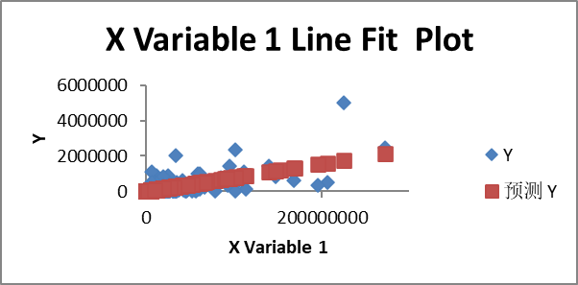
SUMMARY OUTPUT
回归统计
Multiple R | 0.704772
R Square | 0.496704
Adjusted R Square | 0.496388
标准误差 | 143312
观测值 | 1599
方差分析
 | df | SS | MS | F | Significance F
回归分析 | 1 | 3.24E+13 | 3.24E+13 | 1576.081 | 2.3E-240
残差 | 1597 | 3.28E+13 | 2.05E+10
总计 | 1598 | 6.52E+13
 | Coefficients | 标准误差 | t Stat | P-value | Lower 95% | Upper 95% | 下限 95.0% | 上限 95.0%
Intercept | 11166.77 | 3747.938 | 2.979444 | 0.002931 | 3815.375 | 18518.17 | 3815.375 | 18518.17
X Variable 1 | 0.007742 | 0.000195 | 39.69988 | 2.3E-240 | 0.00736 | 0.008125 | 0.00736 | 0.008125
喜欢&不喜欢
Title

Slide 15
不足
Chapter Four

Slide 16
浏览量与上榜时间线性
不足之处
Tag和频道具体类别研究
简介研究

Slide 17
THANKS FOR YOUR ATTENTION
By 梁晨

